Slide 1
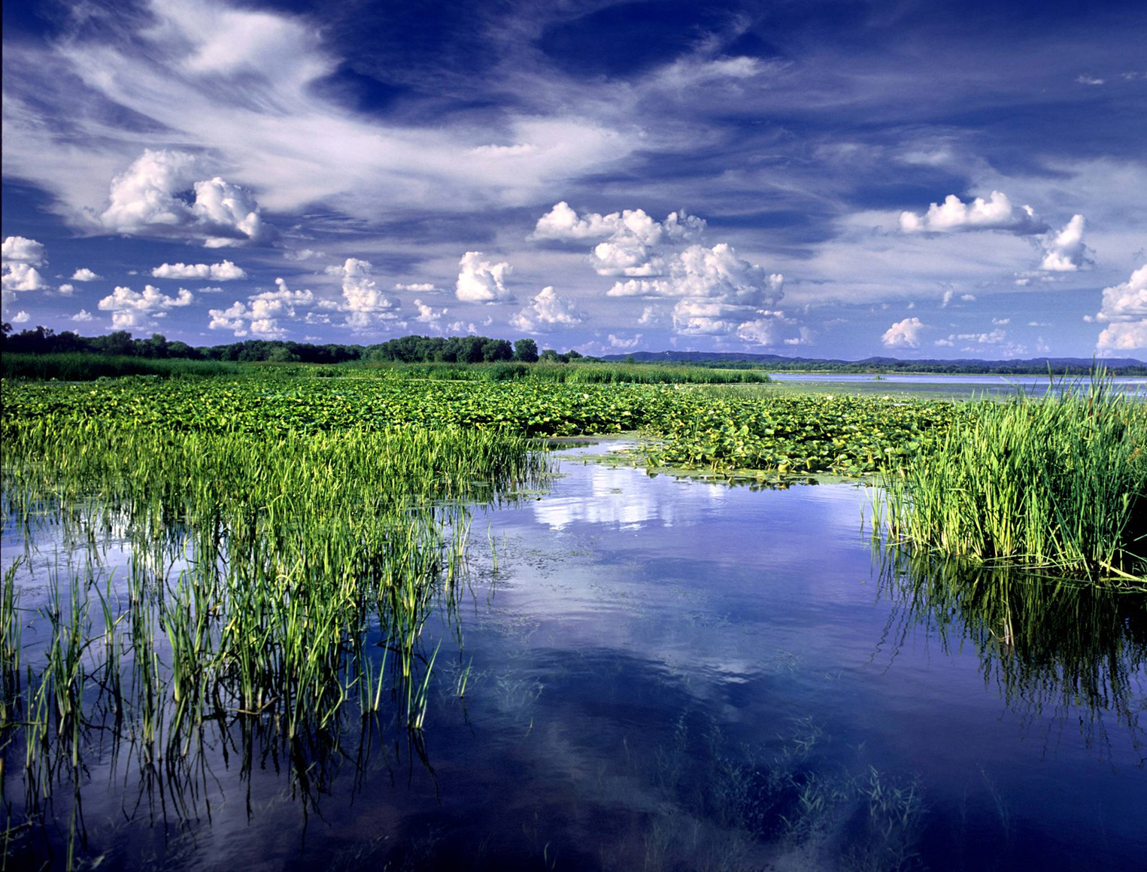
Lake Onalaska Agency Team: Sedimentation and Potential for Habitat Loss
Collaborative Solutions to Keep our Resources Great

Slide 3
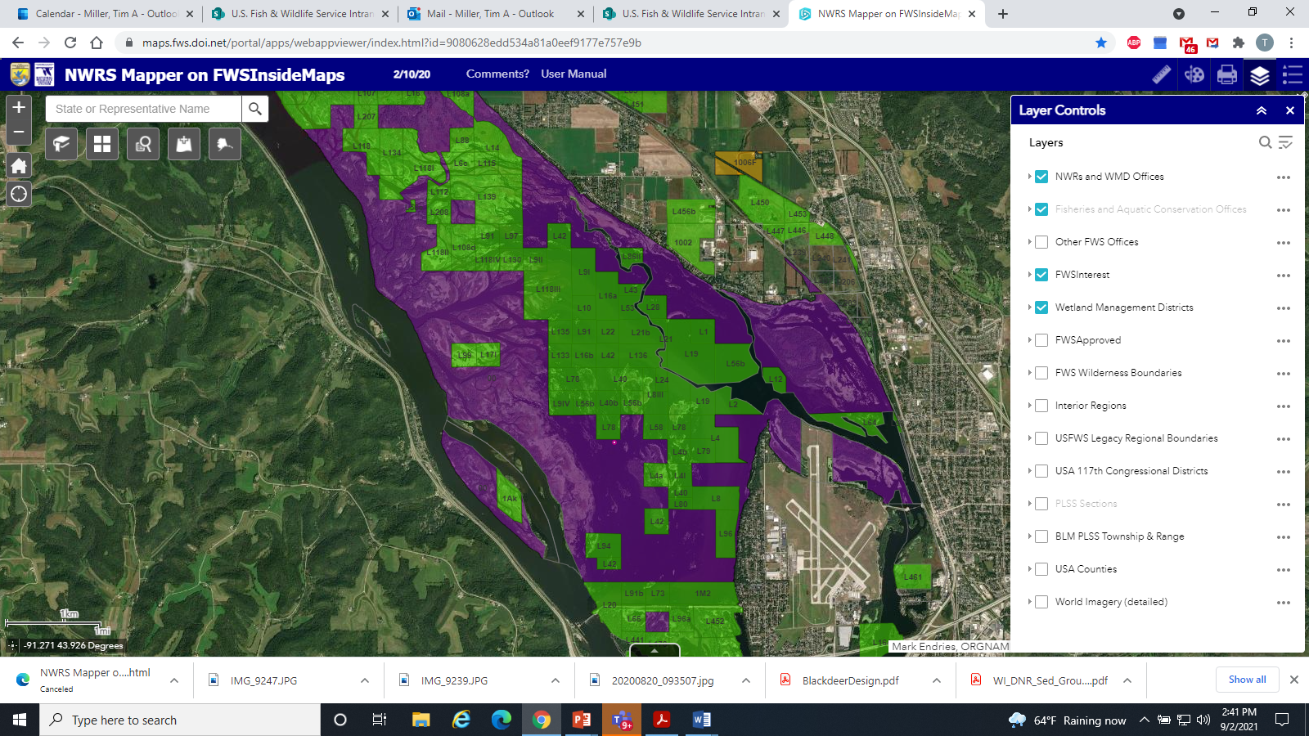

Slide 4
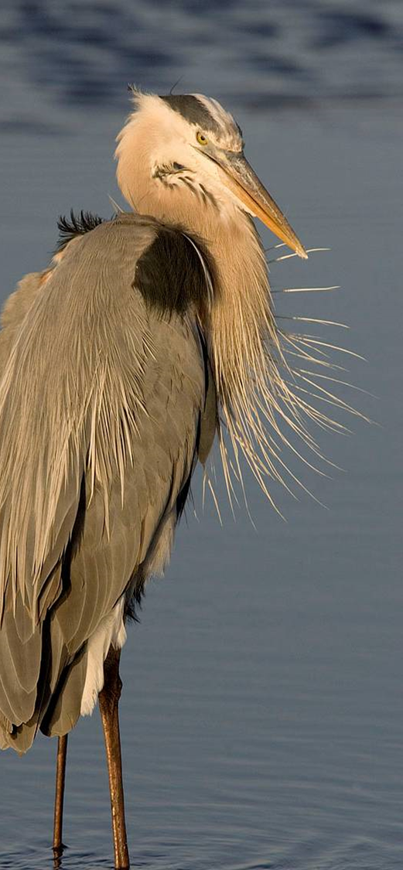
Agency Team:
U. S. Fish and Wildlife Service: Upper Mississippi River National Wildlife and Fish Refuge, La Crosse District.
U. S. Fish and Wildlife Service, Fisheries
U. S. Army Corps of Engineers
U. S. Geological Service
Wisconsin Department of Natural Resources
Minnesota Department of Natural Resources
Lake Onalaska Protection and Rehabilitation District

Slide 5
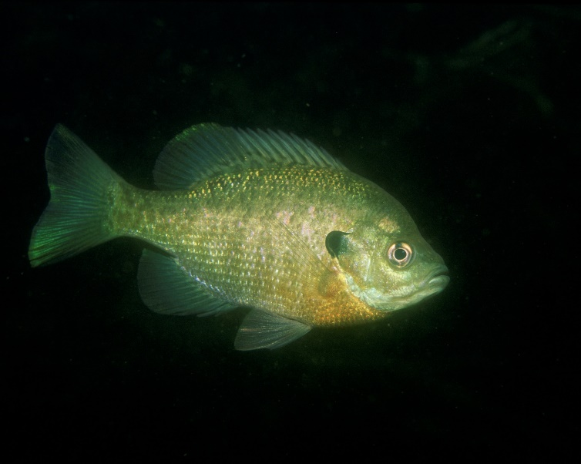
Problem Identification: First Meeting March 10, 2021 From WIDNR
Wisconsin DNR: Sedimentation factors Miss River and Black River and Water Residence Time, loss of Depth Diversity, excessive nutrients resulting from the sediment in turn excessive filamentous algae. Resources of concern: Good water quality in turn good diversity of species and biotic guilds.
Possibilities: Sediment defectors- Bullet, Gibbs, Goose, No Name, Sommers and Proudfoot Chutes.
Focus Projects on areas with low Dissolved Oxygen
Issues with Onalaska Spillway.
Island Building, backwater dredging

Slide 6
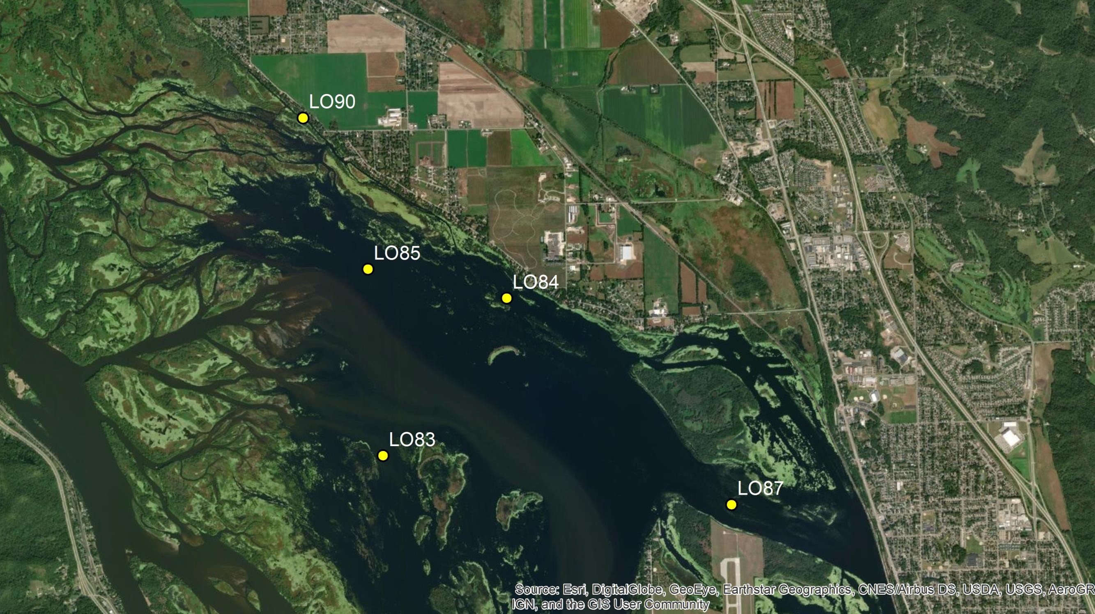

Slide 7
Mean Annual Discharge at Winona 1929-2019
Issue #1: Sedimentation and Water Residence Time
Mean annual discharge on the Mississippi River at Winona never exceeded 45,000 CFS during any year from 1929-1980
80000
70000
Annual Discharge (CFS)
60000
50000
40000
The 45,000 CFS threshold has been exceeded 11x since 1980. Six of these years have been since 2011
30000
20000
10000
0
1920
1940
1960
1980
2000
2020
Year

Slide 8
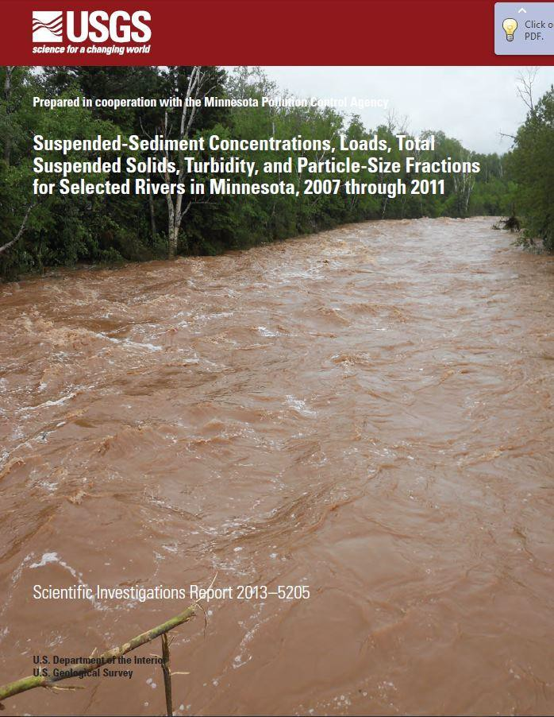
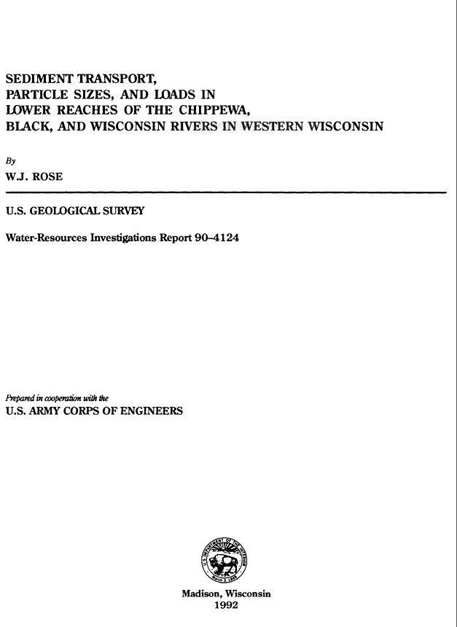
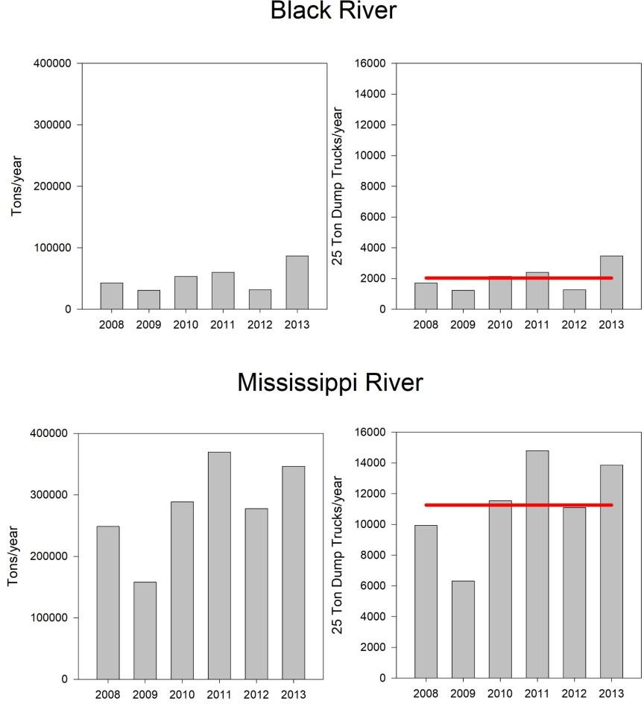
Lake Onalaska Sediment Budget
Ellison Report
Rose Report
Total Sedimentation per year (suspended + sand bedload); ~2000 truckloads/year Black R/ ~11000 truckloads/year Mississippi R. sources

Slide 9
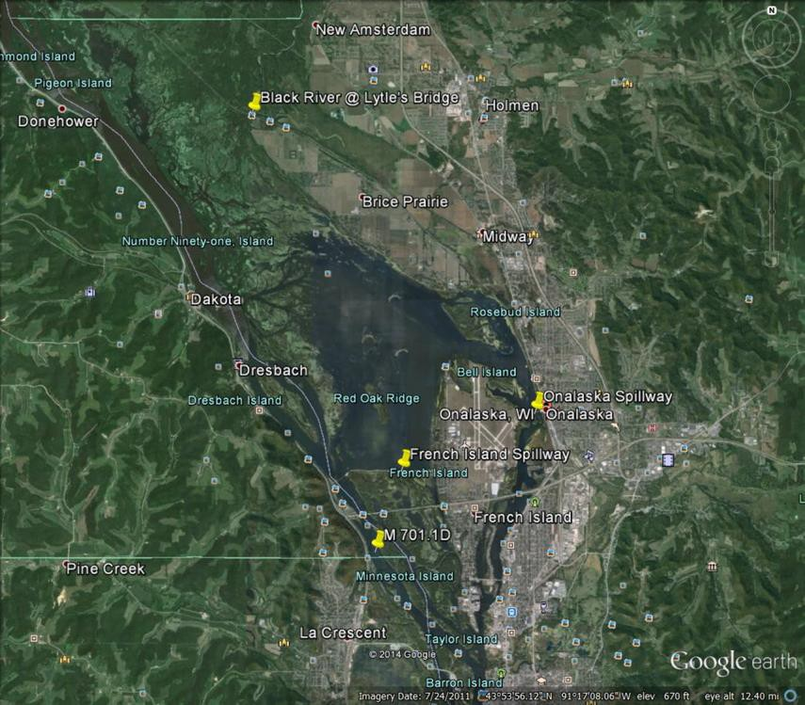
Seasonality of Sediment Trapping Efficiency
More TSS leaving Lake Onalaska than coming during low SAV months (April and November)- Wind Resuspension
Net sediment trapping during most months May-October
40
Total Suspended Solids (mg/L)
30
20
10
0
Estimated TSS Trapping efficiency of Lake Onalaska Median 39.24 %
0
2
4
6
Month
8
10
12
Black R. Onalaska Spillway
French Island Spillway Mississippi R.

Slide 10
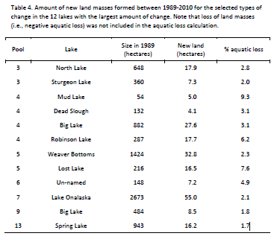
135.9 acres 1989-2010

Slide 11
~4 feet deep
Cold water; high DO
Plenty of oxygen
Water very cold (near 0° C)
~8.5 feet deep
“Sweet Spot” 6.5-10 feet deep
Water warm >1° C Still enough oxygen
Cold water; high DO
~3-4 feet deep
Plenty of oxygen
Water very cold (near 0° C)
Loss of backwater depth occurring in concert with increasing river discharge Deeper backwaters are filling in the fastest

Slide 12
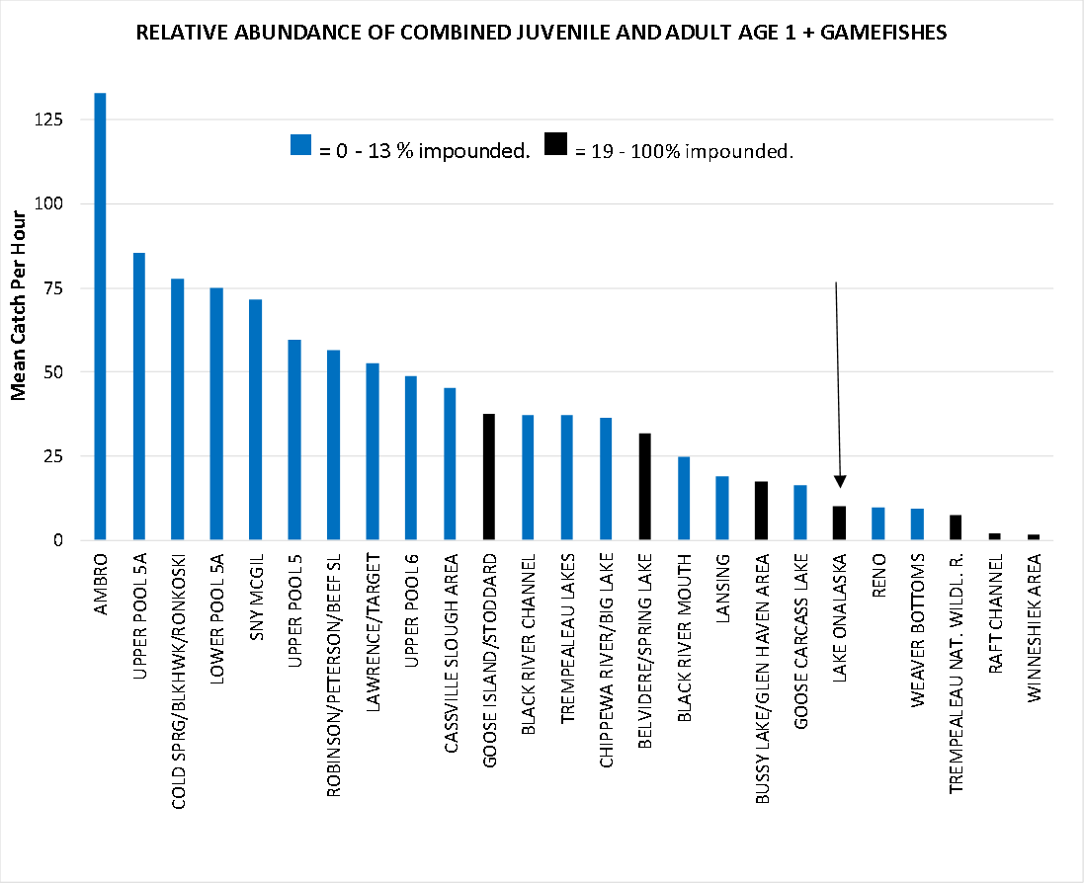
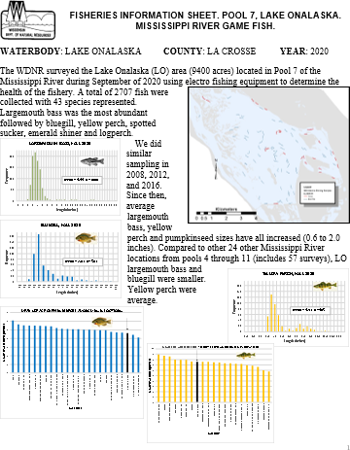
Lake Onalaska, like other highly impounded locations, tends to have low fish numbers. Possibly due to low
habitat and benthic diversity.
YoY gamefish production fairly robust
Somehow doesn’t translate into adult fish production, habitat related?

Slide 13
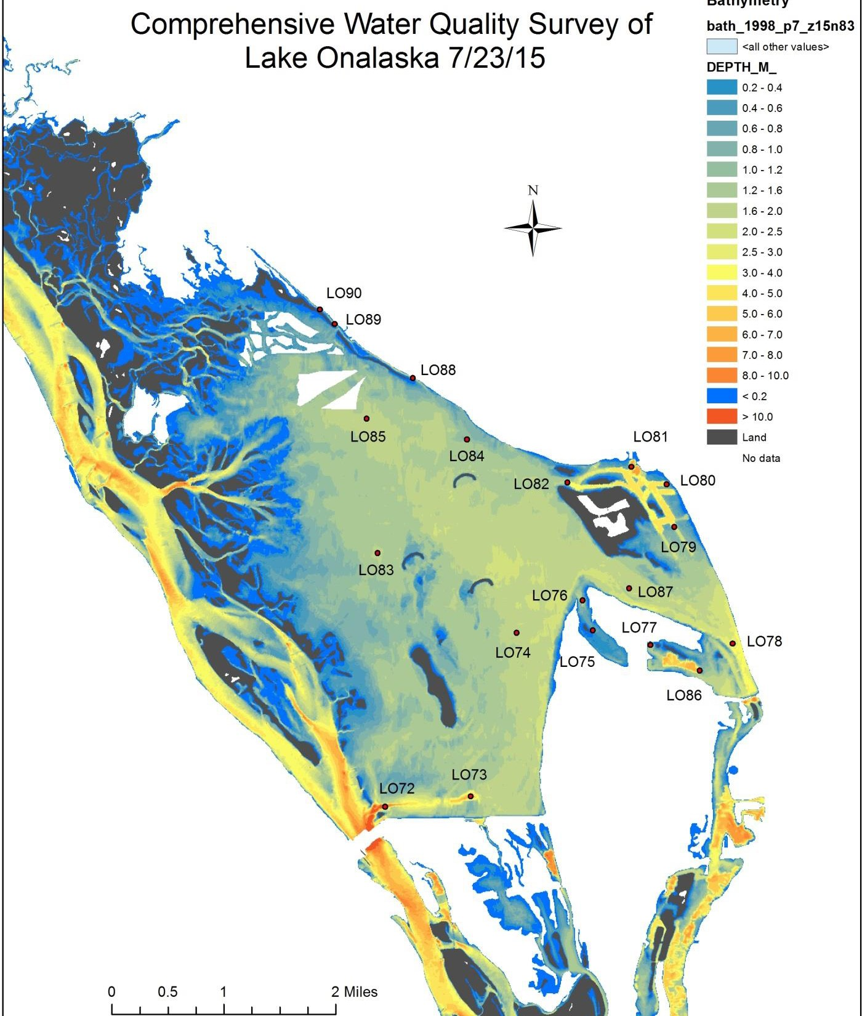
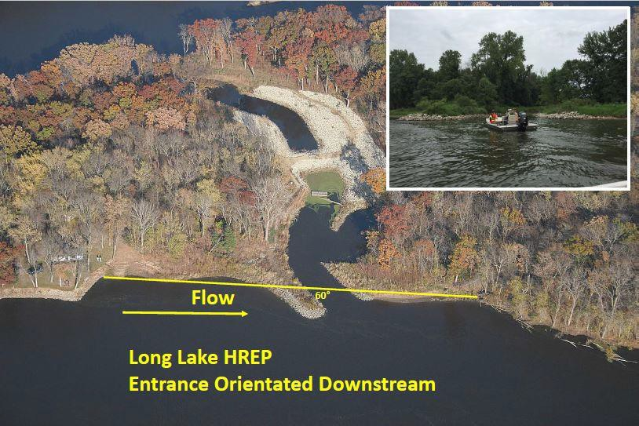
Focus Area: Inlets from Miss. R. MC (Bullet, No Name, Gibbs, Goose, Sommers, Proudfoot)
Bedload Deflectors/Flow Reduction at Miss R.
Channel Inlets

Slide 14
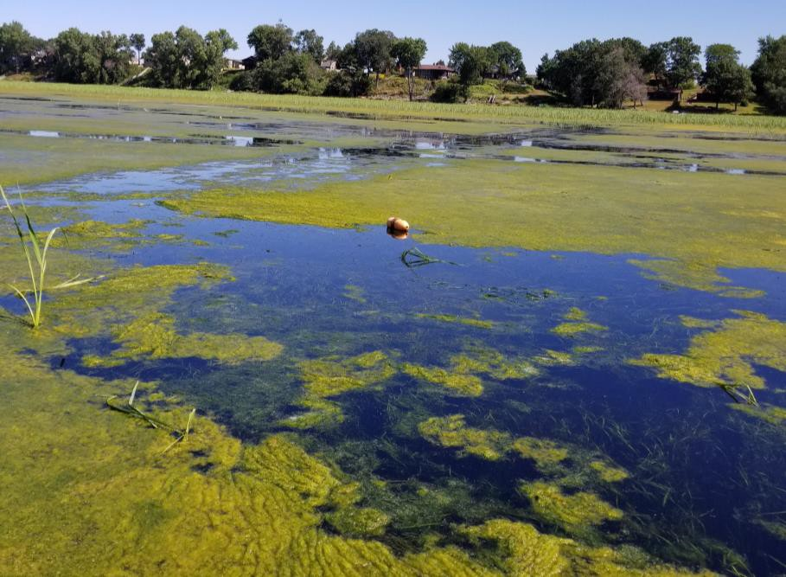
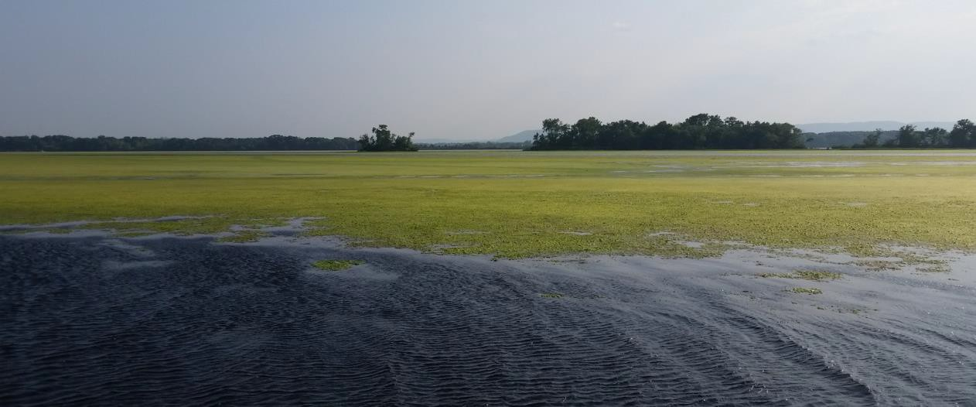
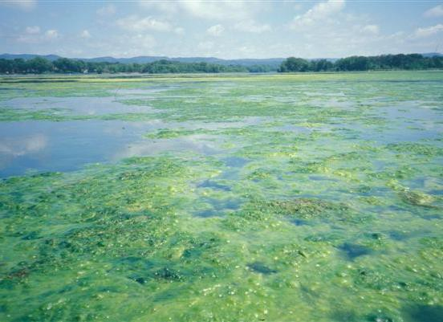
Issue: Excessive Growth of Filamentous Algae and Duckweed
FA and duckweed can negatively affect SAV, which affects wildlife and fish use and WQ
Source of many public complaints
Hypoxia under mats as well- especially duckweed mats >60% coverage
Can be addressed by optimizing water velocity and depth diversity

Slide 15
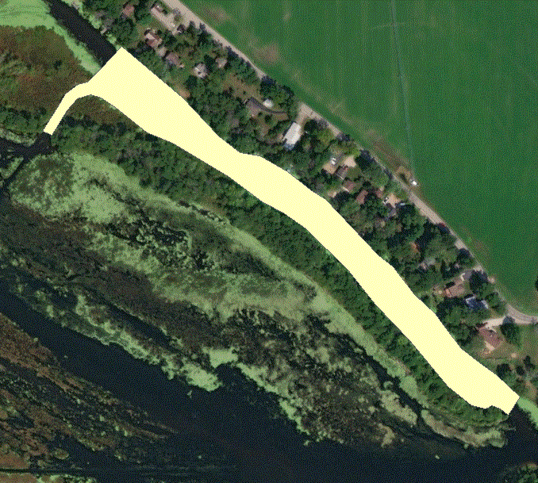
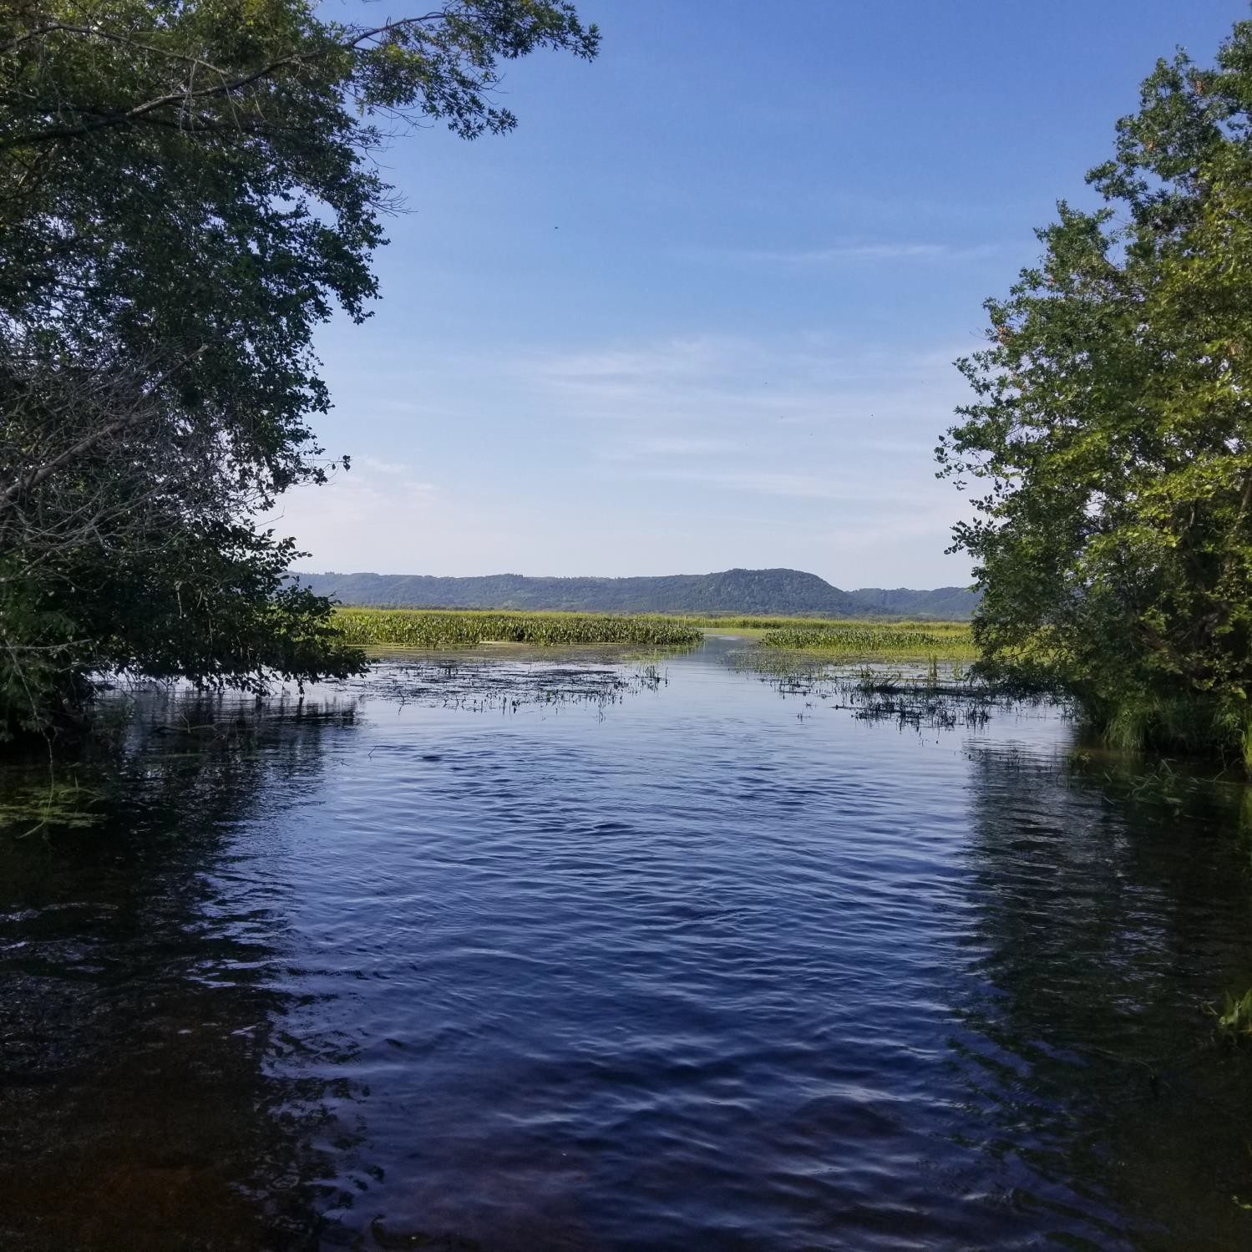
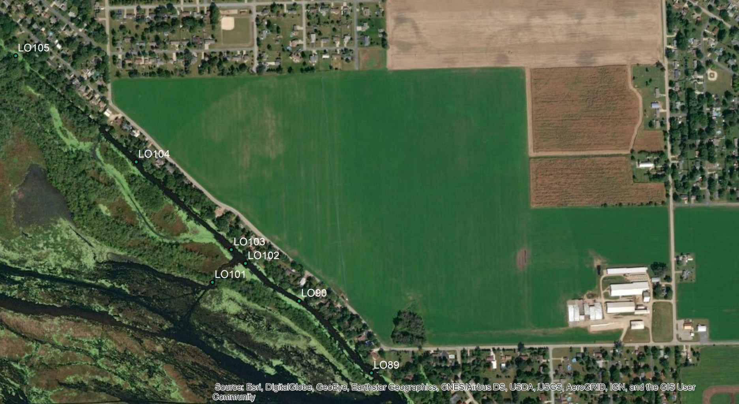
Affected Project area = 5.71 acres
Avg water depth
= 3.46 feet
Notch at LO101
28.97 CFS Residence Time =0.34 days Flushing ~3x/day (way too much flow for optimal winter
water quality)
35 feet opening width
Notch Gauging/Residence Time Data

Slide 16
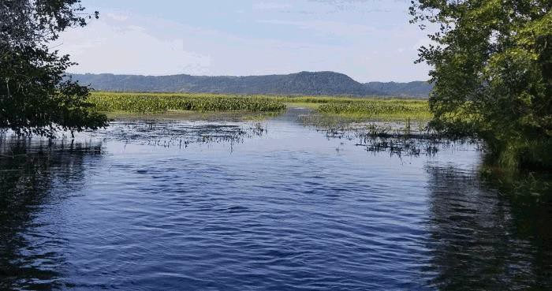

Slide 17
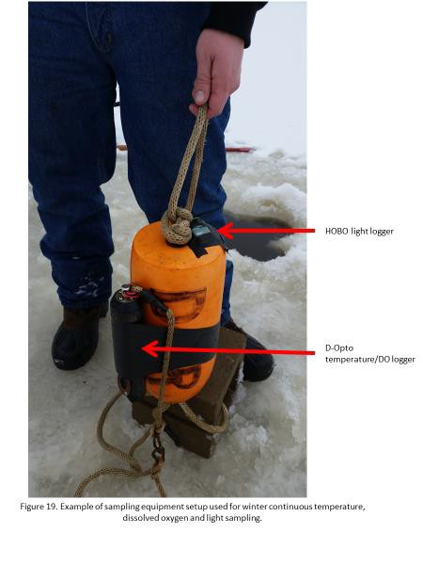
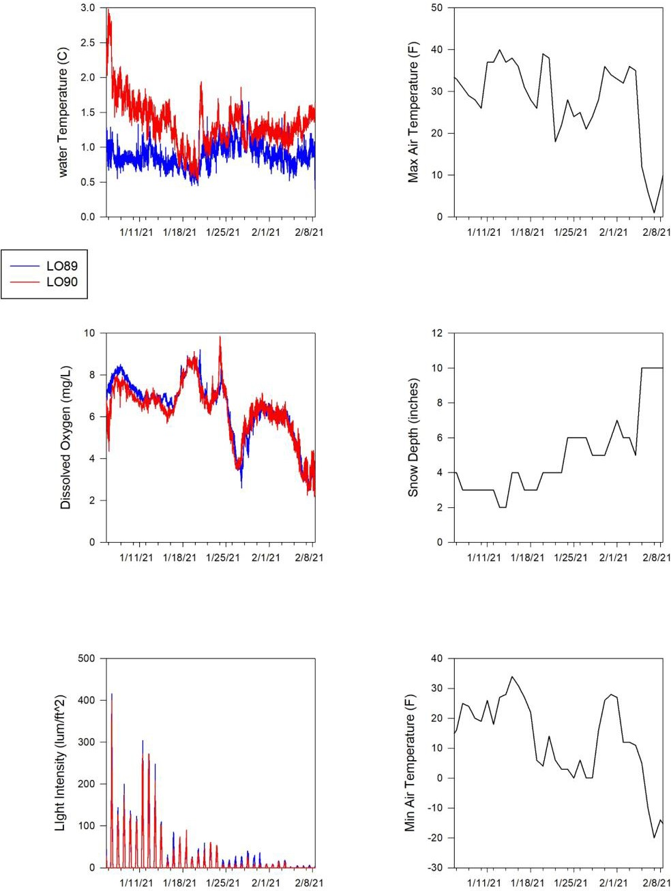
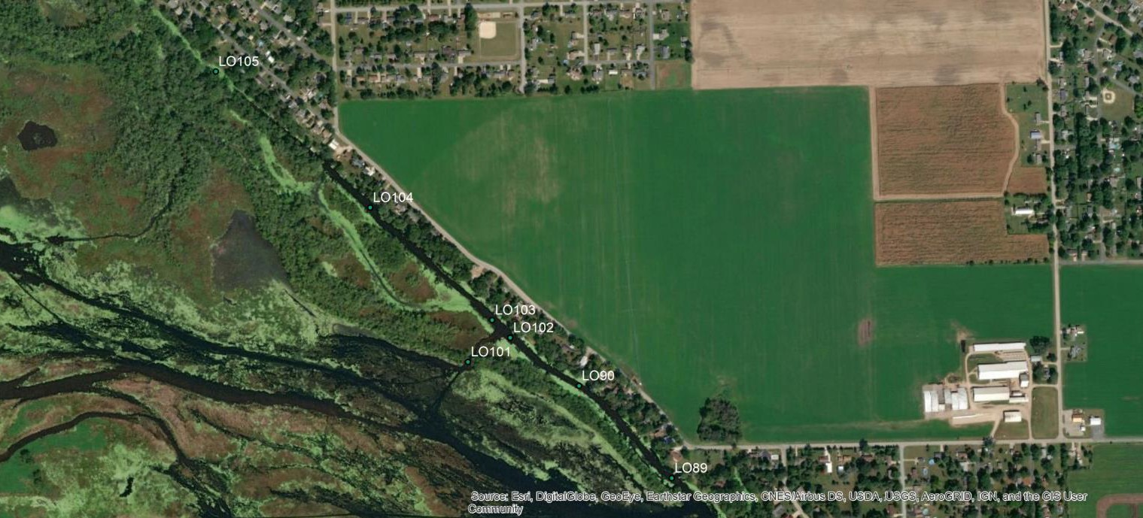
Blackdeer Channel (Brice Prairie Channel)
WQ at LO101 (Notch)
10
DO (mg/L); Temp (C)
8
DO
Temp
6
4
2
0
12/1/20
1/1/21
2/1/21
3/1/21

Slide 18
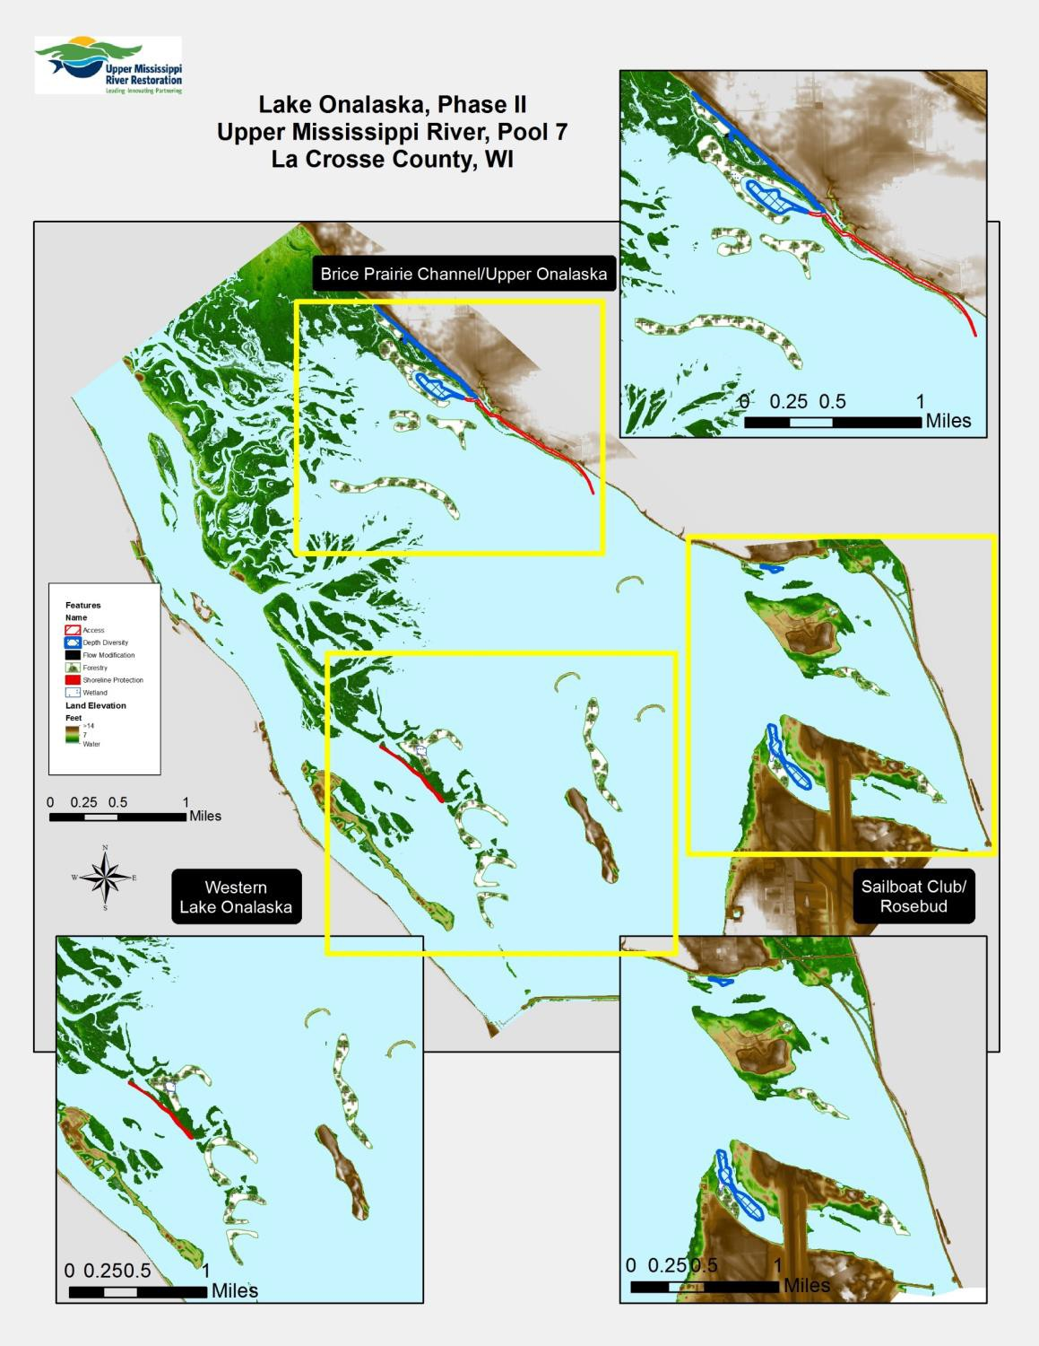
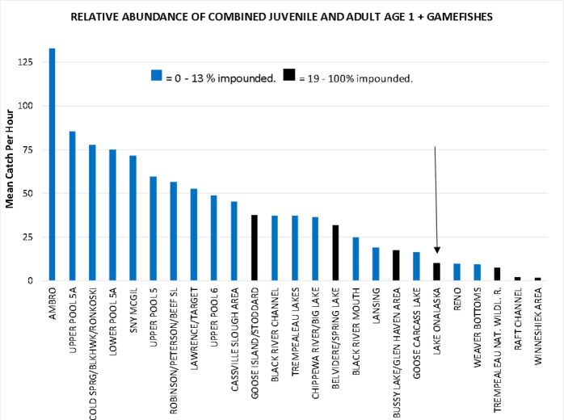
Less focused on specific species more on promoting good water quality and adequate ecological conditions for a variety of biotic guilds.
WI DNR Wildlife- Higher elevation islands for mast producing tree species (e.g. oak; wood duck nesting)
Reduce sedimentation into Lake O- benefits for many fish and wildlife species
Address island dissection on west side of lake to produce better water velocity diversity for better species diversity
Create u-shaped island with deep water interior to enhance water velocity and depth diversity
Islands to manage
sediment

Slide 19
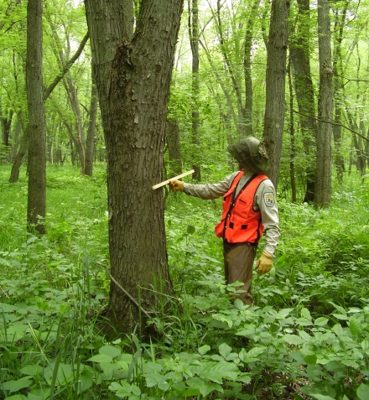
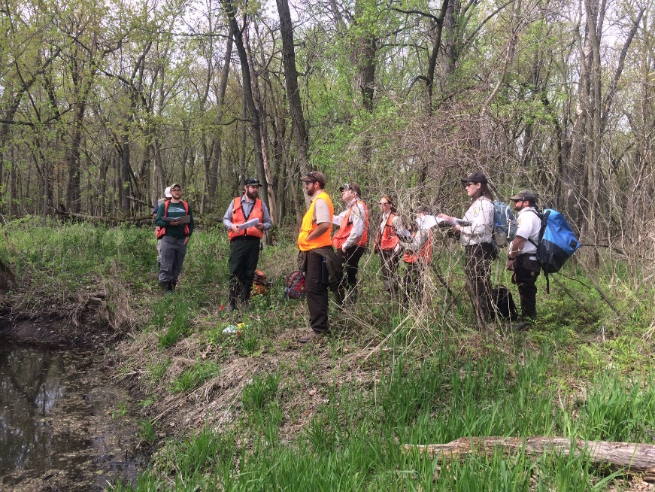
Problem Identification From U. S. Army Corps of Engineers
Can be involved in beneficial use of sediment
Interested in terrestrial benefits: Forestry hard mast species.
Opportunity to develop oak/hickory stands and forest objectives
Protect cultural resources from erosion.
Can provide hydrological modeling support.

Slide 20
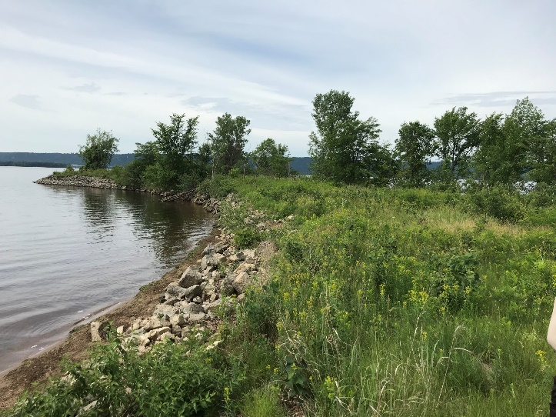
Minnesota Department of Natural Resources
Although not in MN, interested in ecosystem and looking a issues with sedimentation from the Mississippi River and Black River.
Overwintering Fish habitat important
Topographic Diversity: Barrier islands to protect and enhance forestry resources
Island Development: Worked well in the past. Dealing with wind fetch current and re-suspending sediments/nutrients.
Vegetation issue and submersed aquatic plants and Oxygen
Mussel habitat can we consider.

Slide 21
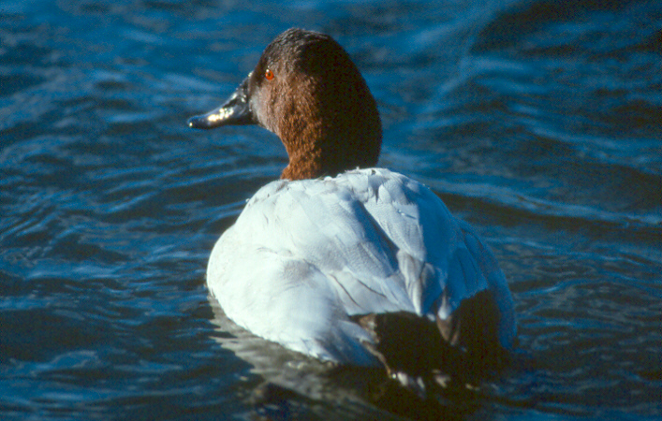
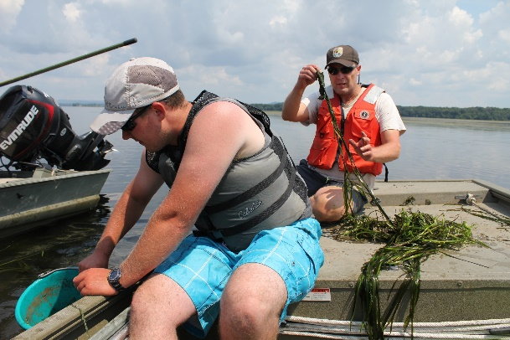
U. S. Fish and Wildlife Service: Upper Mississippi River NW&FR
Priority Resources of Concern: From our Habitat Management Plan:
Lentic Backwater Lake: Priority II Habitat (management actions in partnership):
Priorities Wildlife species
Canvasback Duck and Lesser Scaup, Limnophilic Native Fish: mud darter, weed shiner, pugnose shiner, central mudminnow, pirate perch, bullhead, yellow perch, northern pike, bluegill, bass and crappie Limnophilic Native Mussels: example giant floater
Habitat needs: Water quality to support submersed aquatic vegetation, depth/structural/velocity diversity, protection from disturbance.

Slide 22
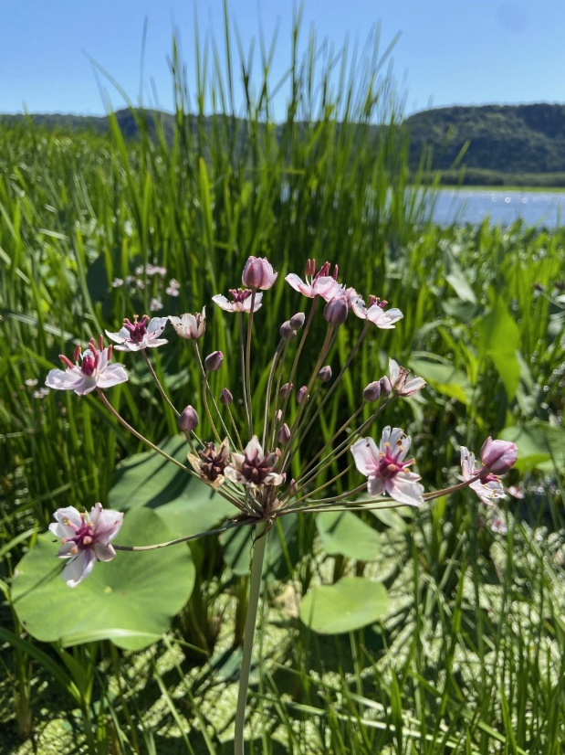
U. S. Fish and Wildlife Service: Upper Mississippi River NW&FR
Challenges on Lake Onalaska as a Lentic Backwater Lake:
Sedimentation
Nutrient Loading- Algal blooms blocking light for SAV.
Loss of Structural/Depth/Velocity Diversity
Invasive Plants: Eurasian watermilfoil, curly leaf pondweed, flowering rush
Invasive species: Faucet snails, zebra mussels, invasive carp???

Slide 23
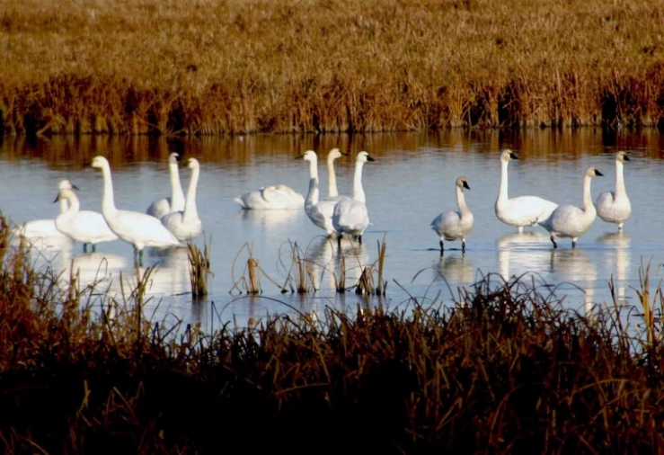
U. S. Fish and Wildlife Service: Upper Mississippi River NW&FR
Marsh Habitat Type: Priority 1- Black River Delta, Sommers Chute
Resources of concern: Tundra swan, dabbling ducks, secretive marsh birds, black tern.
Habitat needs: emergent/submerged plant diversity, water quality, seasonal depth changes (draw downs), stable conditions during the growing season.
Challenges on Lake O:
Sedimentation caused conversion of marsh habitat to wet meadow (reed canary grass dominated)
Invasives: flowering rush, reed canary grass, purple loosestrife
Lack of draw downs. Inundation during growing season.
Nutrient loading

Slide 24
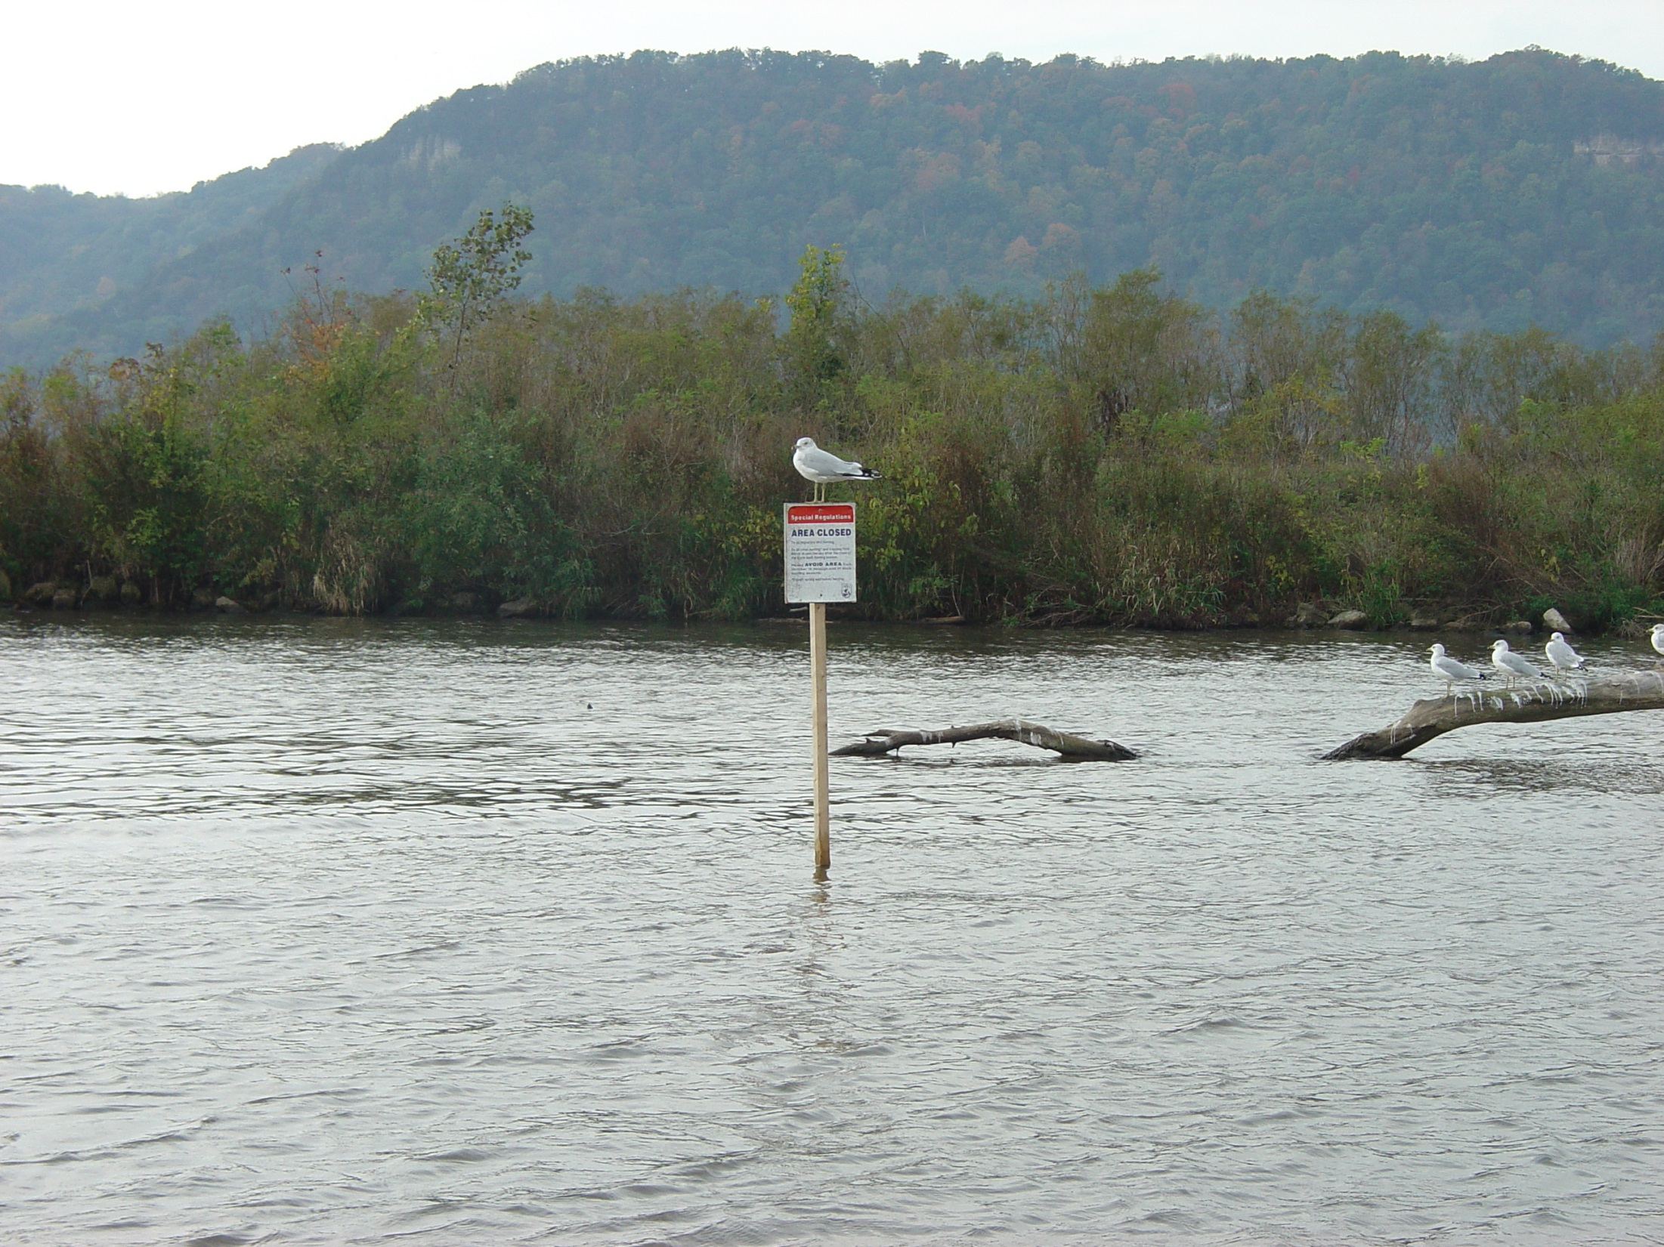
U. S. Fish and Wildlife Service: Upper Mississippi River NW&FR
Lake Onalaska Closed Area and Voluntary Waterfowl Avoidance Area
7,348 acres protects critical feeding resting areas for migrating waterfowl and waterbirds
Canvasback ducks: supported by wild celery beds, aquatic plants, invertebrates for food and energy: Critical migration habitat
Issues with disturbance
Tundra Swans: arrowhead beds, other aquatic plants resting foraging.

Slide 25
U. S. Fish and Wildlife Service: Upper Mississippi River NW&FR
Big Issues Lake Onalaska:
Sedimentation
Loss of structural diversity
Watershed Issue: Increase tile drainage, farming practices, land development, lack of watershed buffers.
Difficult to work with diverters due to navigation.
Work with smaller chutes: Gibbs, Goose, Bullet and No Name.
Black River Influence: Hydrology changes, silting in transition to Tank Creek.
Nutrient loading. Nutrients are essential for the system, but what to do with too much.
Waterfowl Disturbance during critical times.

Slide 26
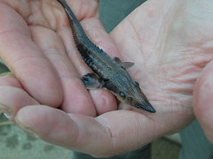
U. S. Fish and Wildlife Service Fisheries
Interested in the Watershed Approach to issues of sedimentation and nutrients.
Good Projects in Trempealeau and Buffalo Counties: Early stages we can learn from. Fishers and Farmers

Slide 27
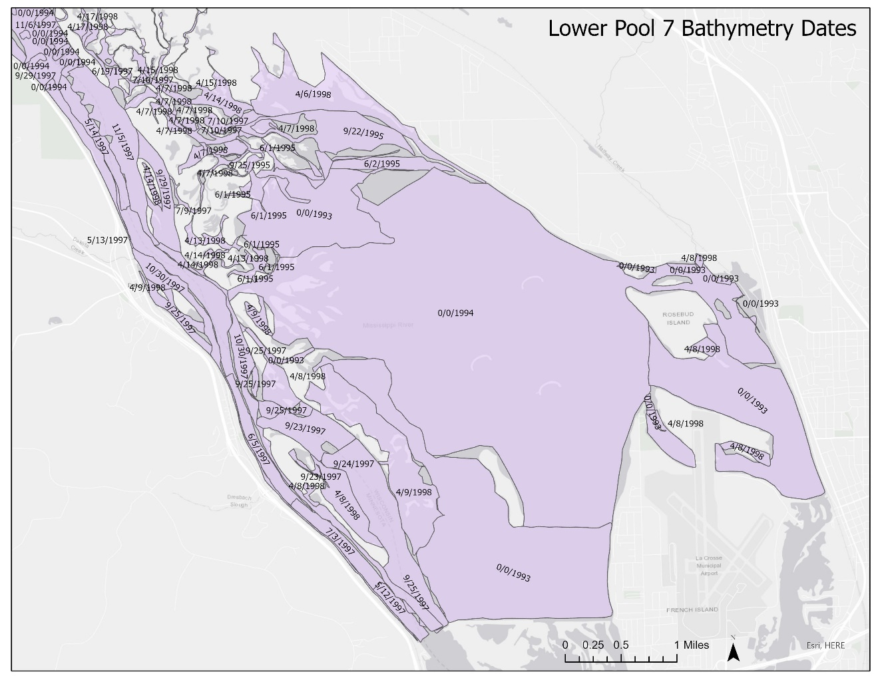
U. S. Geological Service
Science: Can provide data and answer questions from the group.
Land cover data
Wind fetch
Bathymetry
Sedimentation studies

Slide 28
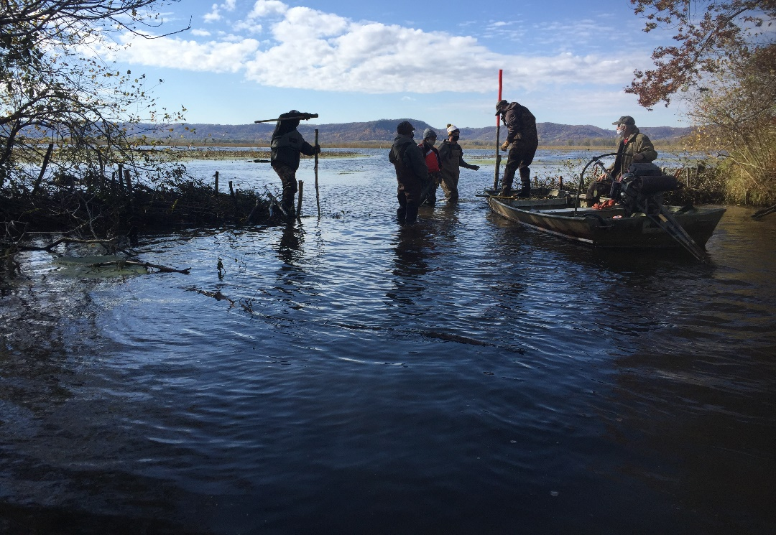
Lake Onalaska Protection and Rehabilitation District
Sedimentation, Loss of structural diversity
Need for current bathymetry
Put science behind proposals.
What will the habitat look like in 50 years or more.

Slide 29
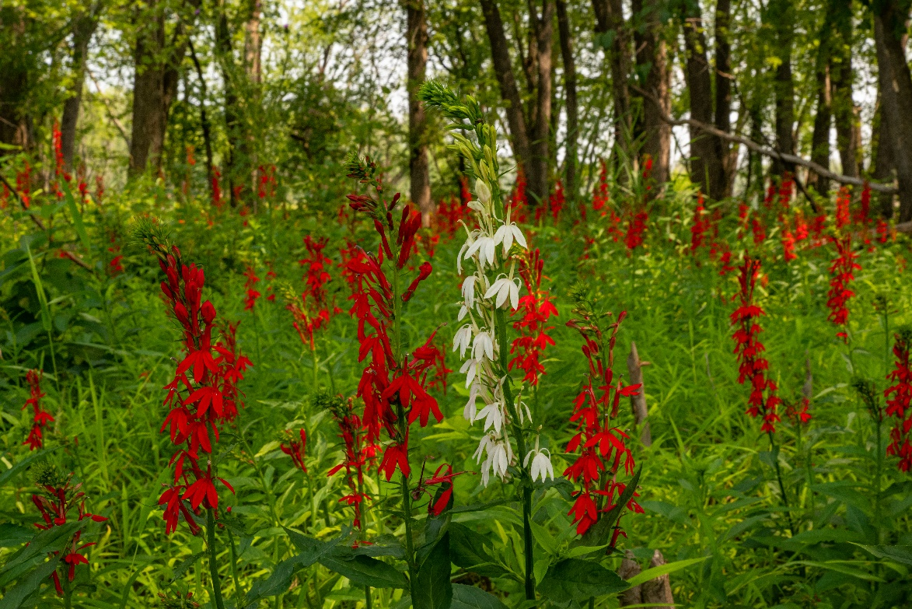
Over lapping Issues/concerns from first meeting
Topographic/bathymetric diversity loss
Loss of overwintering fish habitat
Diversion/sediment reduction potential sediment defectors
Water quality and nutrient loading
Wildlife Habitat protection and diversity
Opportunity to develop habitat
Watershed Issues
Bathymetry
Long Range Projections

Slide 30
Agency Team Meeting #2 May 11, 2021
Sediment Deflectors on Smaller chutes: Engineering and feasibility
Nutrient Loading: Long and short term: Need for some type of nutrient budget
Loss of depth Diversity: Island construction where is best. Invasive issues.
Habitat Development: use of dredge material to protect the Lake barrier islands.
Watershed Issues: Possible Legislation assistance.

Slide 31
Proposed NESP (Navigation and Ecosystem Sustainability Program)
Proposed in Summer 2021 in the Saint Paul District Fish and Wildlife Working Group.
Project would fund Science and construction needs:
Feasibility of Sediment Diverters on the smaller chutes
Sediment trainers on Sommers Chute for habitat features
Long range projections: modeling status of habitat features for Refuge ROCs.
Updated bathymetry
Restore habitat features feasibility/construction/dredging: Sailboat Club bay, Brice Prairie Channel, Western Lake O. and possible island construction.
Selected in the top 10 projects. Sent to the River Resources Forum.

